Slide 1
XSS Me: Revised
Group 1: Sam Dlinn, Ginger Yu, Nisha Tangirala

Slide 2
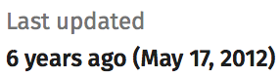
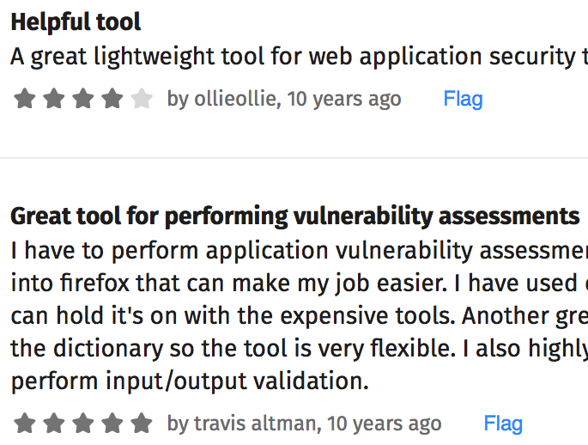
XSS Me is really old.
OWASP defines XSS as “a type of injection, in which malicious scripts are injected into otherwise benign and trusted web sites.”
XSS Me was an extension developed by Security Compass for testing xss vulnerabilities on user-defined websites.
Notes:
XSS has been on OWASP's list of top 10 vulnerabilities for many years and will continue to be a problem
XSS me was developed around 10 years ago for Firefox and is no longer being supported. it was one of the top XSS checking extensions, and had a large user base. we would like to update or rewrite the code for use on modern browsers and with modern exploits.

Slide 3
Implementation
2 ways of going about it:
Try to get the existing source code for XSS ME and build on top of it, update it to include modern attacks.
Create an extension implementation from scratch that tests for XSS vulnerabilities in recent browsers.
Extension will be written in JavaScript and will be present on the Firefox browser.
After the user accesses a web page, they can have the extension run tests on the web page to check for XSS vulnerabilities. The extension will then return a result.

Slide 4
Deliverables
Midterm Deliverables:
Prototype code
Proof of concept
Short demo
Plan A:
FireFox Add-on
Plan B:
Grease Monkey Script
Final Deliverables:
Full project Code
Documentation
Demo - presentation
Live extension testing

Slide 5

Questions???

Slide 6
Sources
https://addons.mozilla.org/en-US/firefox/addon/xss-me/
https://www.owasp.org/index.php/Cross-site_Scripting_(XSS)
https://www.owasp.org/index.php/Testing_for_Reflected_Cross_site_scripting_(OTG-INPVAL-001)

